Slide 1
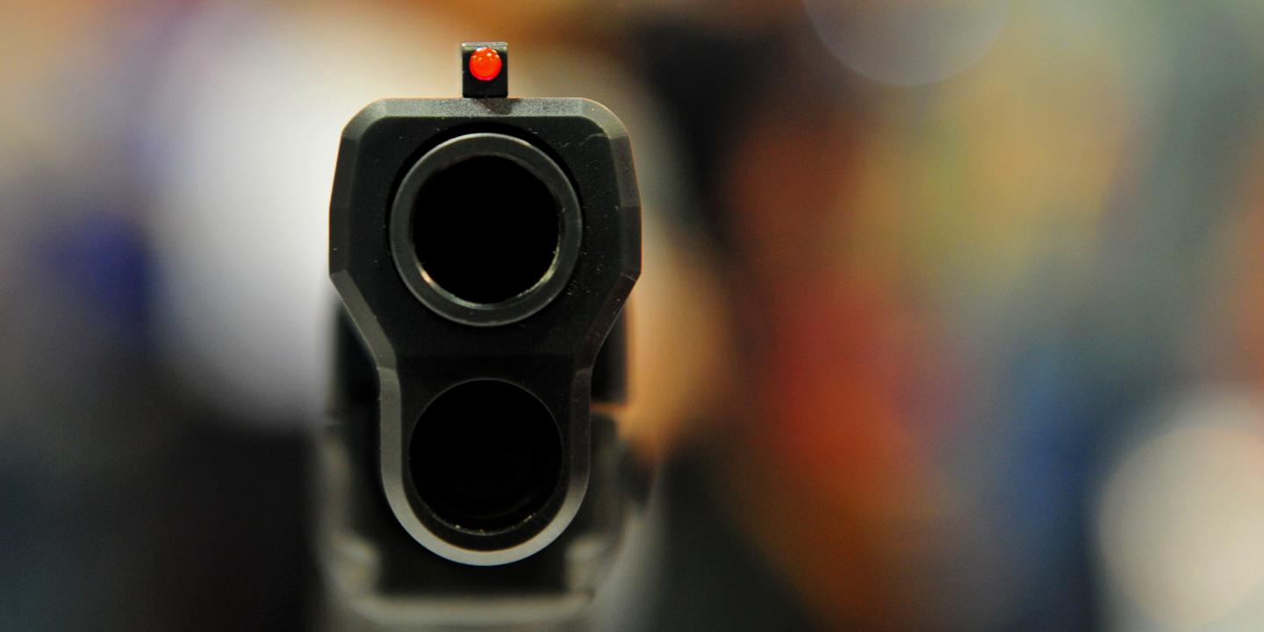

Police Shooting in the US Fact vs. Myth
Bip Gauli
MSDS 692
Regis University

Slide 2
Agenda
Problem description
Datasets
Data prepping
Exploratory data analysis
Visualizations
Correlation
Forecasting
conclusion

Slide 3
Problem description
Are people of color being impacted the most?
Are there any other socio-economic factors Tied to shooting?
how does the shooting trend will look like in the future?

Slide 4
Datasets
Primary (Washington Post)
Shooting dataset
Secondary [Census.gov]
Mobile house rate
Vehicle ownership rate
Bachelor’s degree rate
Median income
Poverty rate

Slide 5
Datasets
Shooting dataset
Contains descriptive information for Shooting from 2015-2021
Close to 6k records
name
Age
Gender
Race
Location
Victim Armed?

Slide 6


Data prepping and tools
Jupiter notebook and Python
Custom columns: Month Year, year, Age Banding: under 10, 10-19, 20-29, etc.
using state name dataset to join multiple datasets

Slide 7
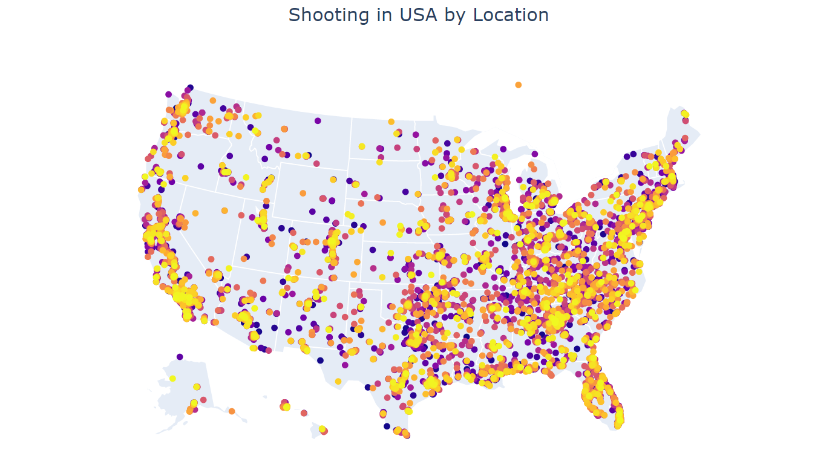
Shooting across the US

Slide 8
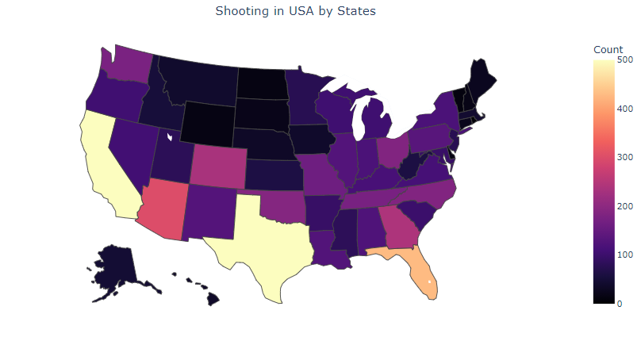
Shooting count by state

Slide 9
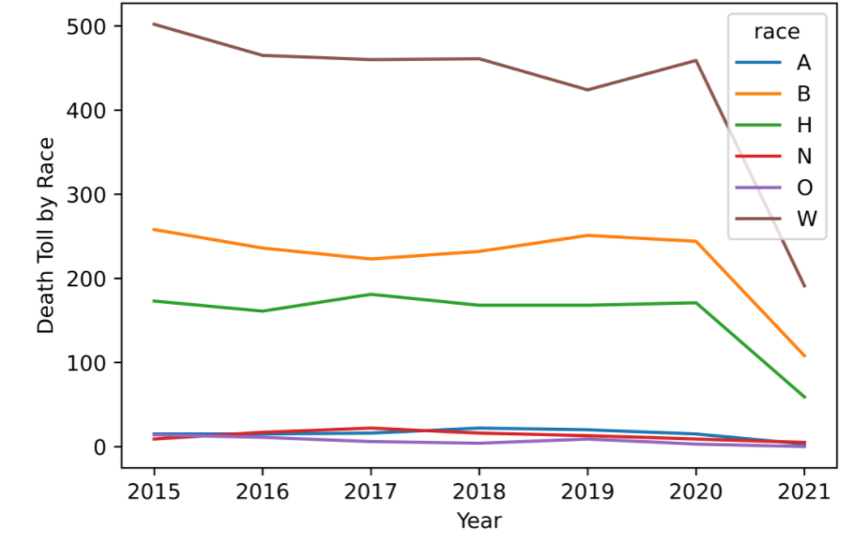
Shooting trend by race and year

Slide 10
Shooting trend by race and year

Slide 11
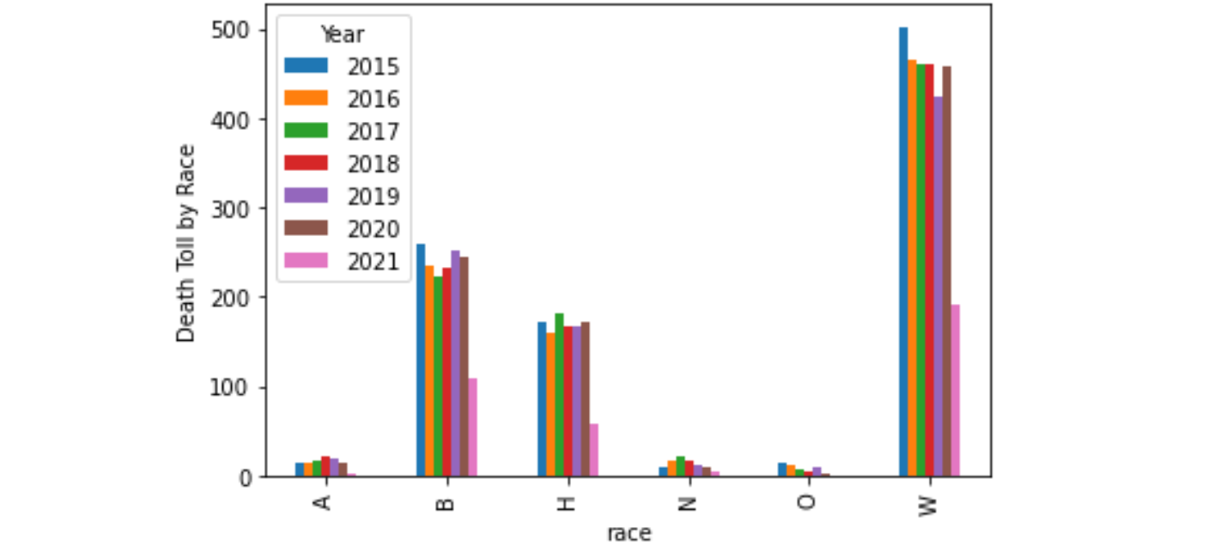
Shooting trend by race and year

Slide 12
Are victims armed?

Slide 13

Weapon-cloud

Slide 14
Shooting by Age Band

Slide 15
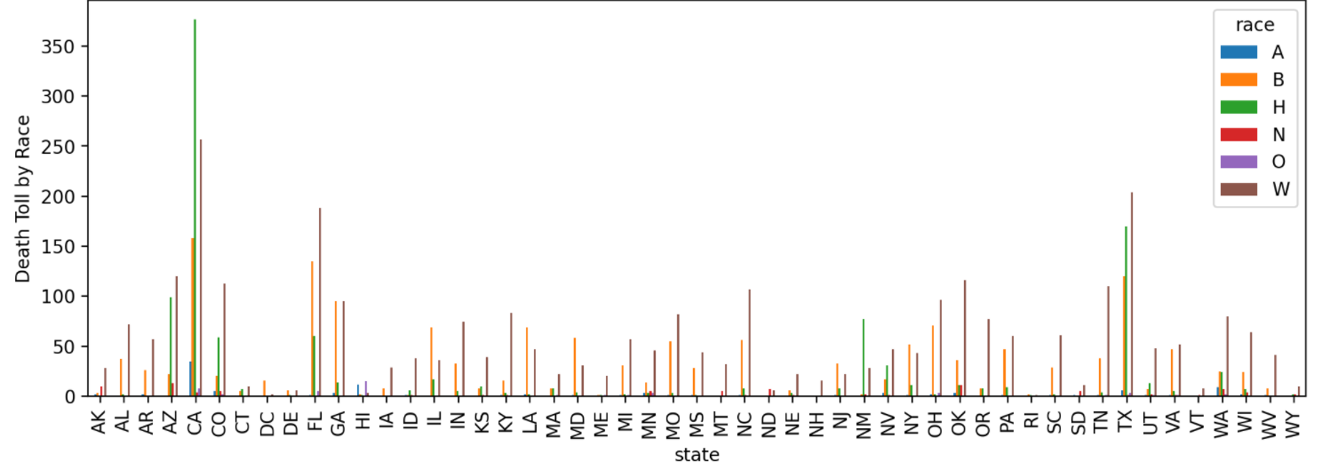
Shooting by state and race

Slide 16
Top 10 states

Slide 17
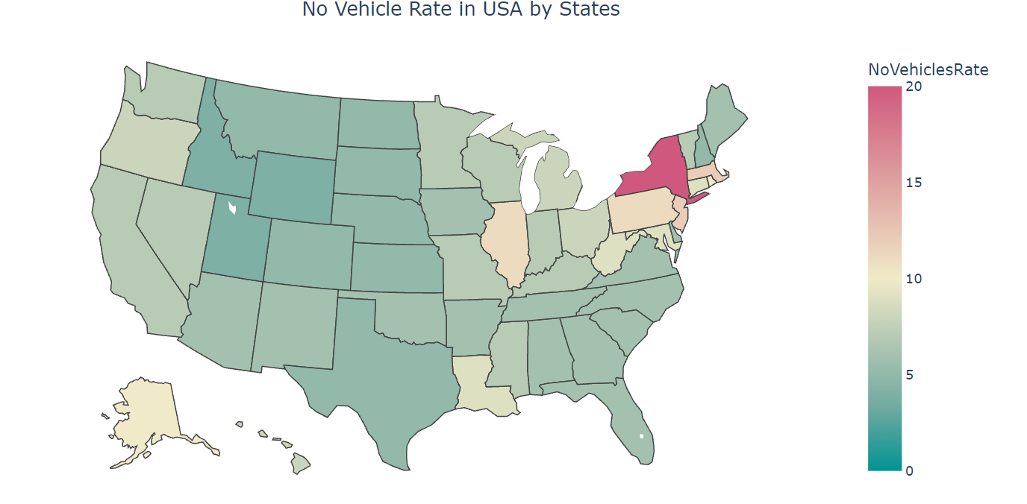
No vehicle rate in the us

Slide 18
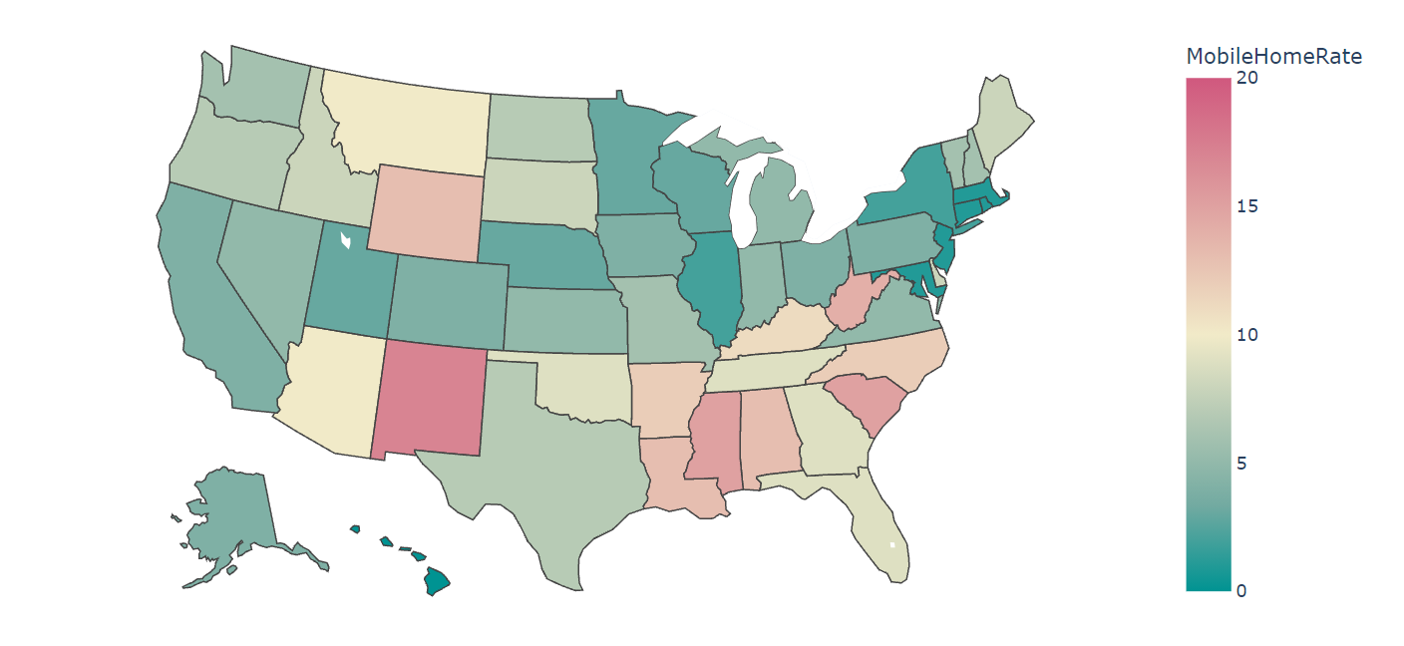
Mobile home rate in the us

Slide 19
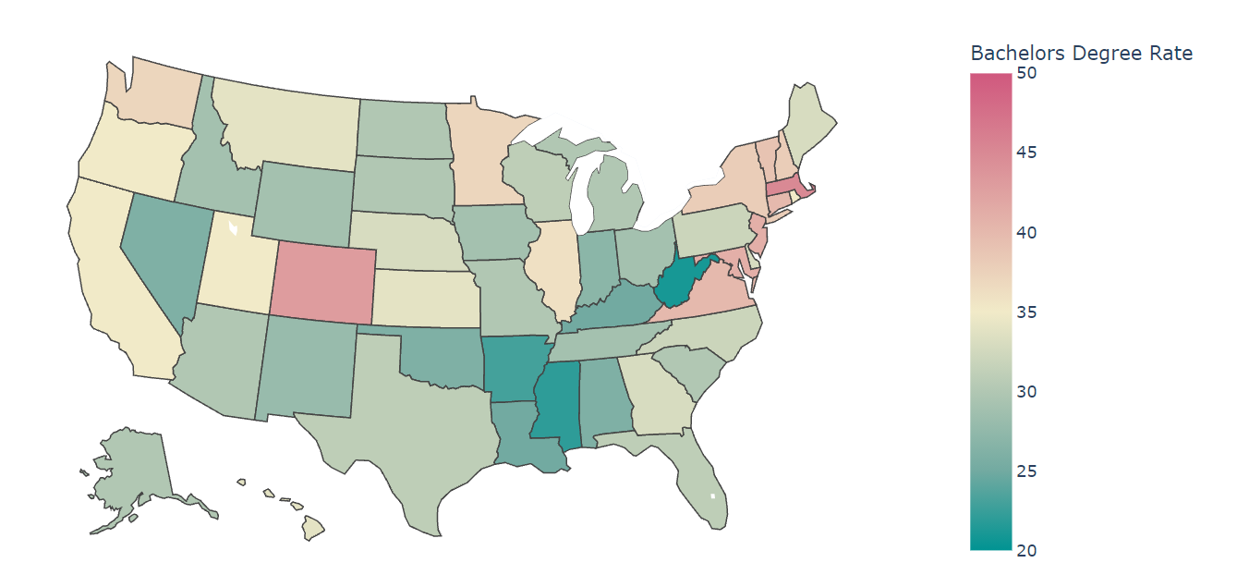
Bachelors' degree rate in the us

Slide 20
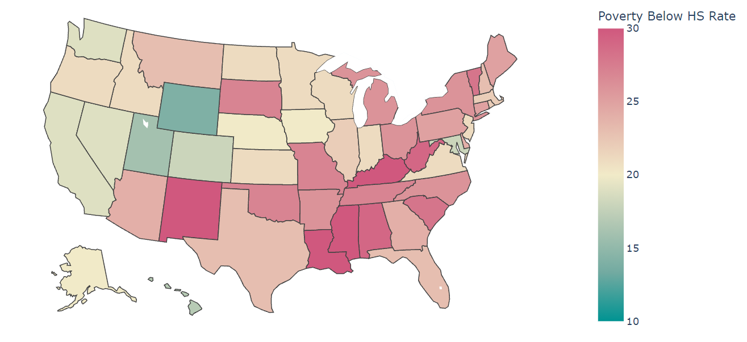
Poverty rate in the us

Slide 21
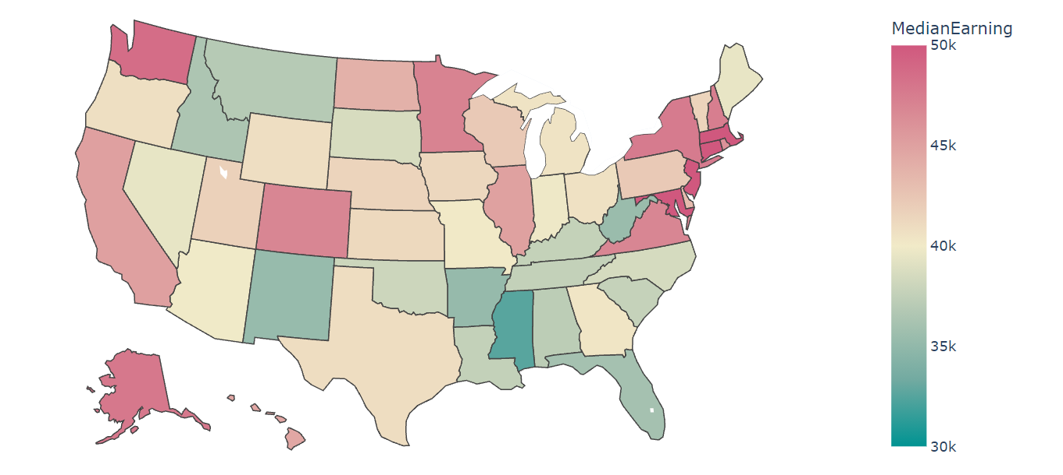
Median Earning in the us

Slide 22
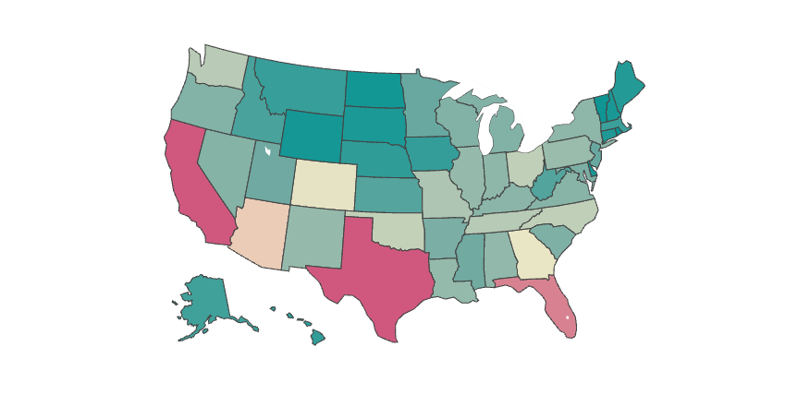
Exploratory data analysis
NO VEHICLE RATE
MEDIAN EARNING
DEGREE RATE
MOBILE HOME RATE
POVERTY RATE

Slide 23
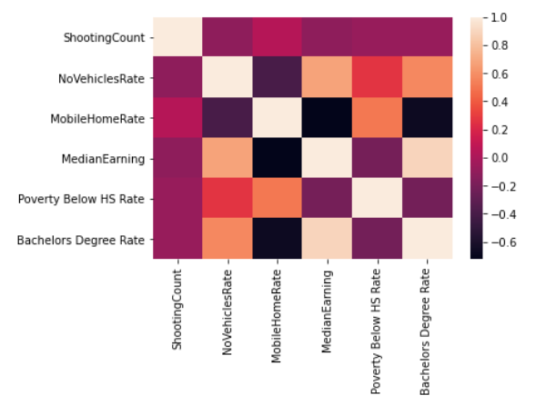
Correlation plot

Slide 24
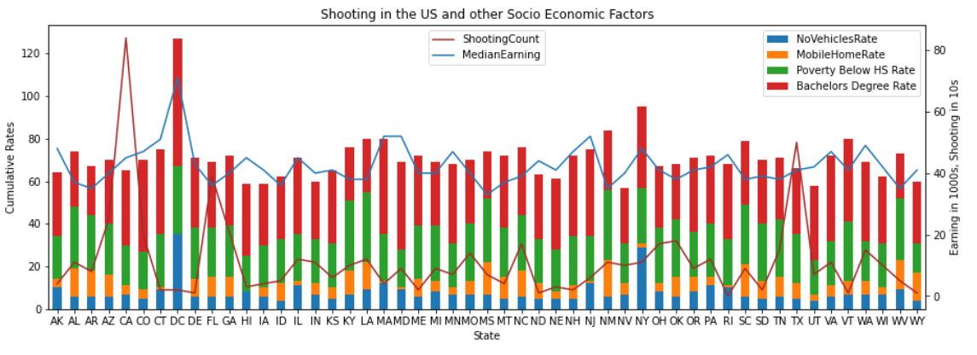
Combination chart

Slide 25
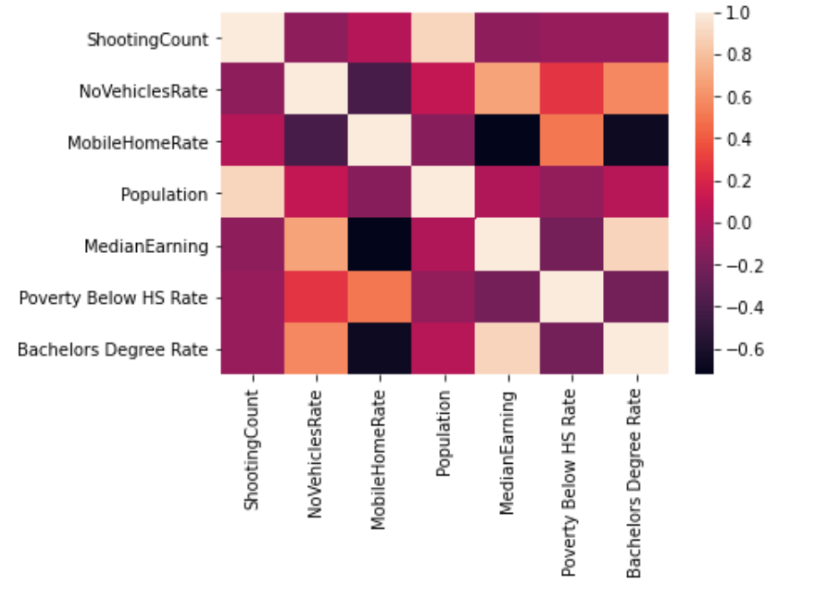
Correlation plot & Population

Slide 26
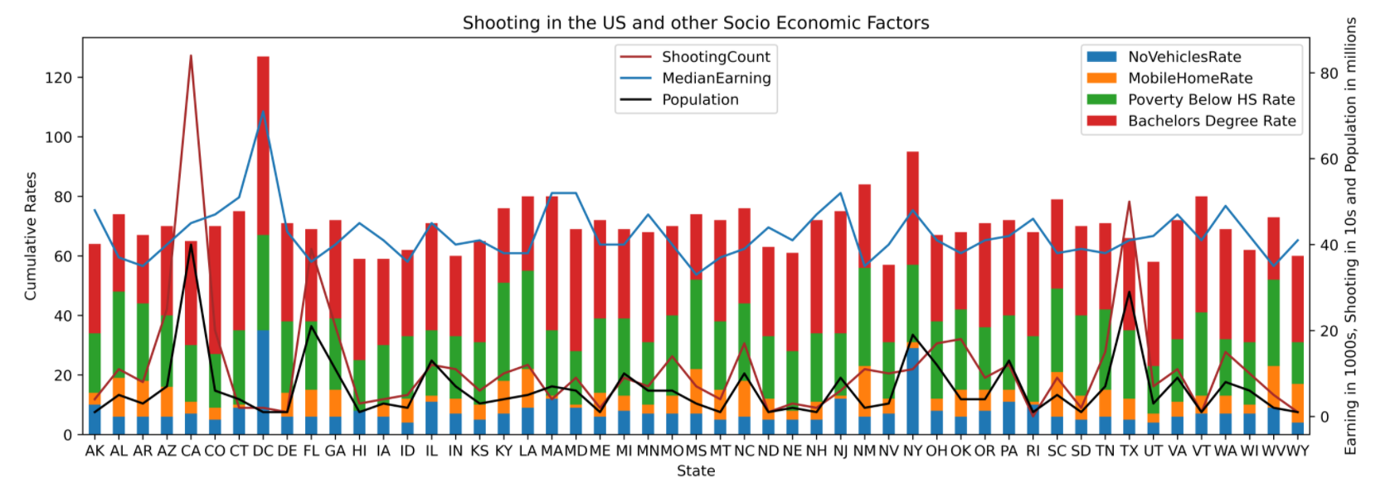
Combination chart & Population

Slide 27
Shooting count per Million

Slide 28
Before and After
Normal Count
Per Million Count

Slide 29
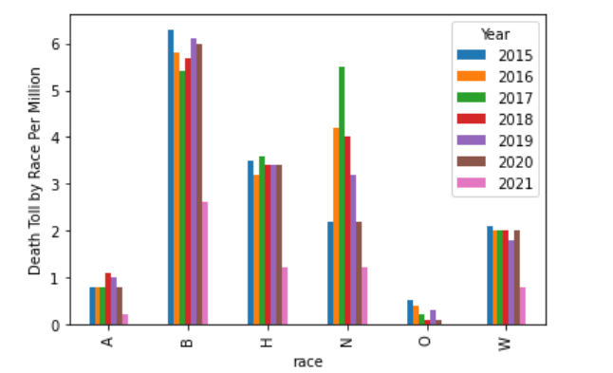
Shooting count per Million

Slide 30
Shooting count per Million
Normal Count
Per Million Count

Slide 31

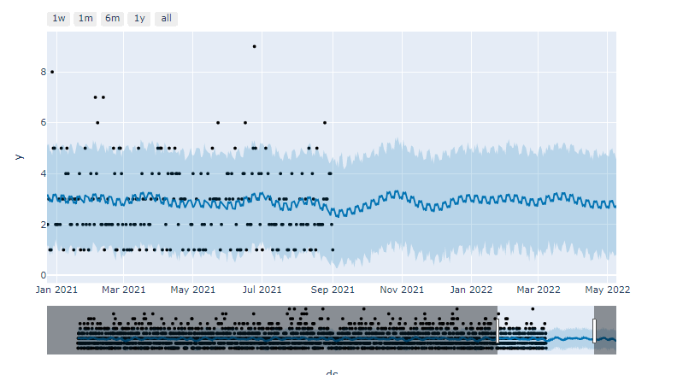
Forecasting

Slide 32
Historical Trend

Slide 33
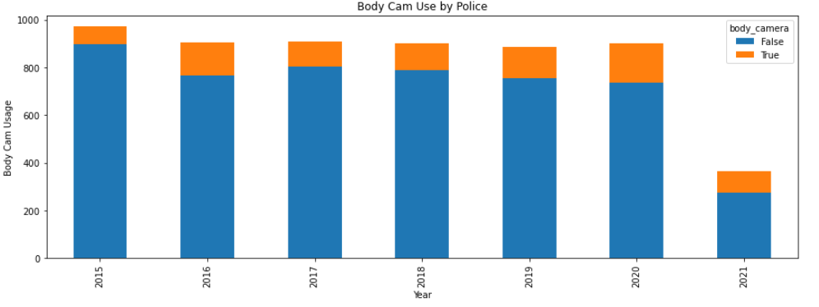
Obstacle?

Slide 34
Summary
Are people of color being impacted the most?
Not at first glance.. But Yes, black and Hispanic seem to be impacted the most
Are there any other socio-economic factors tied to shooting?
Not really
how does the shooting trend will look like in the future?
The trend seems to continue

Slide 35
Questions/ comments?

